Slide 1
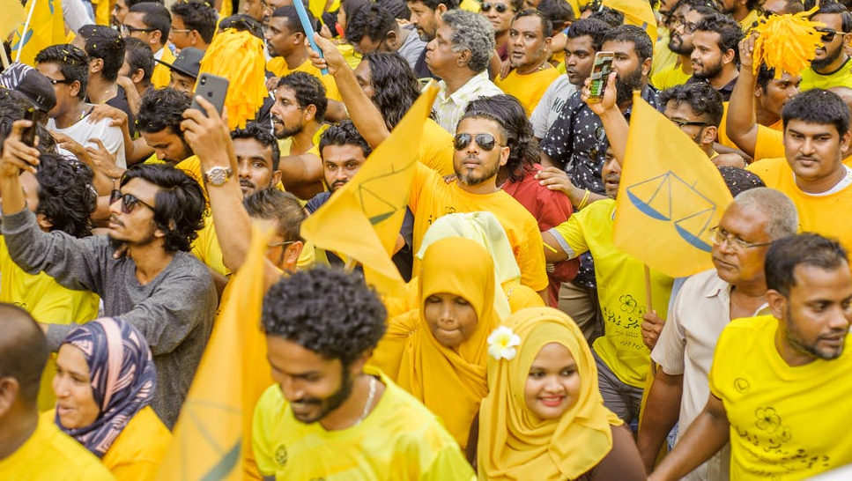
SOCIAL ACTION
GNED 500
Week 12
Photo by Asad Photo Maldives – Pexels

Slide 2

AGENDA
What is Social Action
Activists
Getting Involved
Thinking Critically About Social Action
Models of Social Action
Social Aid or Financial Gain
Critical Thinking about Big Aid
Social Action from the Bottom Up
Grassroots Activism
Online Activism
Social Entrepreneurship
Social Impact
Social Movements
Types of Social Movements
Social Justice and Charity
Activism, Allyship, & Advocacy
Backlash
Questions
Check 3d by d3images - freepik.com
Notes:
Understanding Equity & Equality
Meritocracy
Deficit Thinking
Social Inequality
Indigenous People
Indigenous or Aboriginal
Treaty Rights
Treaties
The Indian Act
Residential Schools
The 60’s Scoop
The Millennial Scoop
Truth & Reconciliation
UNDRIP
Questions

Slide 3

LEARNING OUTCOMES
Students will learn and reliably demonstrate the ability to:
Describe the models of social action
Evaluate social action in a case study based on current events
Synthesize the connection between social action and global citizenship
LEARNING
OUTCOMES
Vector by pch.vector - freepik.com
Notes:
Students will learn and reliably demonstrate the ability to:
Differentiate between equity and equality
Understand the roots of colonialism and how it leads to internalized colonization
Examine the issue of race in relation to equity
Understand deficit thinking, meritocracy, neoliberalism, and tokenism
Recognize that power and privilege are contextual

Slide 4
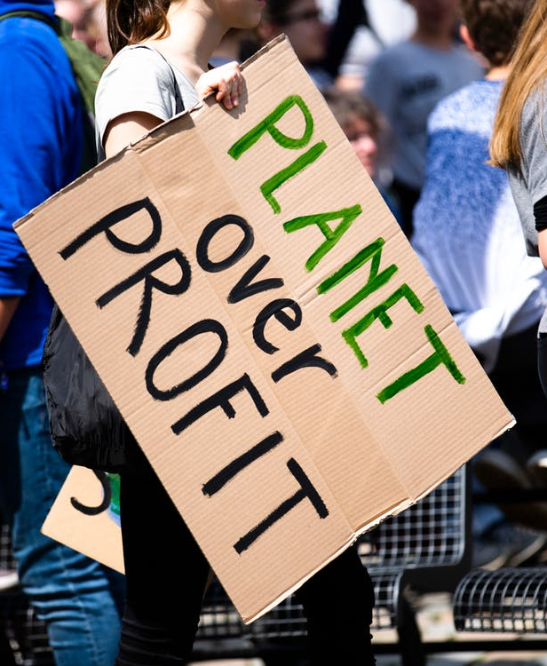
What is social action?
Social Action is any action of an individual or group who seeks to promote social change on a small or large scale.
Social Action occurs when we move from “this isn’t fair” to “let’s make it fair.”
Social action is about seeing something you think is wrong and trying to make it right.
Photo by Markus Spiske from Pexels
Notes:
Social Action is any action of an individual or group who seeks to promote social change on a small or large scale.
Social Action occurs when we move from “this isn’t fair” to “let’s make it fair.”
Social action is about seeing something you think is wrong and trying to make it right.
And an activist is an individual who devotes time to work (either paid or unpaid) to bring about social change.

Slide 5
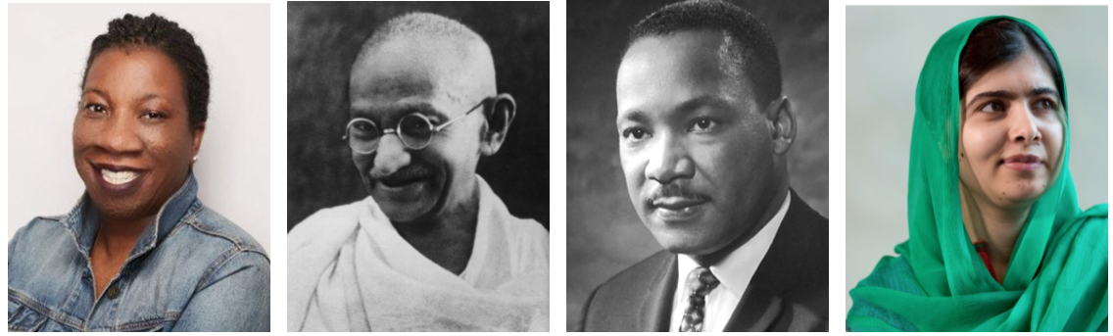
ACTIVISTS
Mentimeter.com 29081272
https://www.menti.com/1pa2yhtkza
An activist is an individual who devotes time & work (either paid or unpaid) to bring about social change.
Can you identify these famous activists?
Take a look at the above people; do you know who they are and what they are know for?
Notes:
Can you identify these famous activists?
Take a look at the following people; do you know who they are?

Slide 6
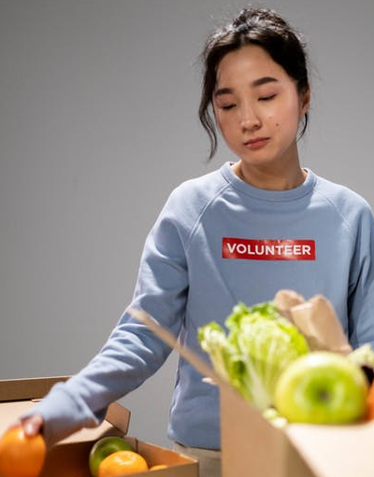
GETTING INVOLVED!
There is more to social action than the willingness to get involved.
We have to think about whether or not our actions are working towards or coming in the way of social justice.
The following two short clips satirize Western attempts to help Africans by drawing attention to the fact that, however well-intentioned, it is important to be conscious and reflective of our actions. Good intentions can sometimes do more harm than good.
Photo by cottonbro
Notes:
There is more to social action than the willingness to get involved.
We have to think about whether or not our actions are working towards or coming in the way of social justice.
The following two short clips satirize Western attempts to help Africans by drawing attention to the fact that, however well-intentioned, it is important to be conscious and reflective of our actions. Good intentions can sometimes do more harm than good.
Who Wants to be a Volunteer?: http://youtu.be/ymcflrj_rRc
Let’s Save Africa! – Gone Wrong: http://youtu.be/xbqA6o8_WC0

Slide 7

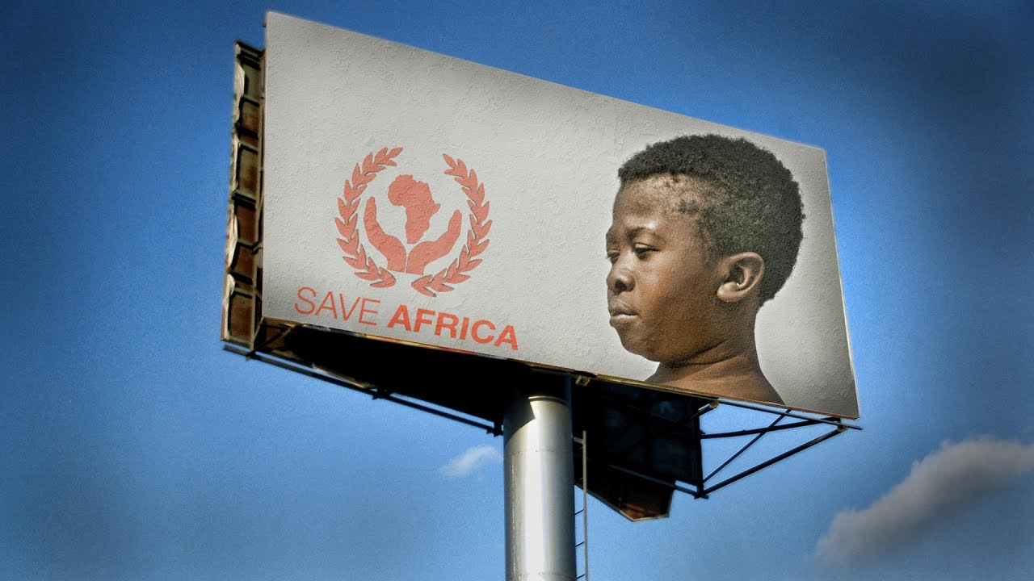
Notes:
Lets Save Africa!
There's no such thing as charity actors. But in our video, did you recognize stereotypes frequently used in fundraising campaigns? Hunger and poverty is ugly, and it calls for action. However, we need to create engagement built on knowledge, not stereotypes
https://youtu.be/xbqA6o8_WC0

Slide 8


Notes:
Look no further.
This is how to get more likes on social media. ...
Or is it? Check out our new guide, "How to communicate the world?
A Social Media Guide for Volunteers & Travelers!
How To Get More Likes On Social Media
https://youtu.be/7c9mwY31iMI

Slide 9

Thinking Critically about Social Action?
Social action is usually understood as an action that promotes a goal of positive change.
However, as our beliefs, values, and ideologies differ, so do our ideas about what constitutes positive change.
It is important to note that not all social action works towards social justice. Social action can be initiated by anyone with any agenda.
In fact, much social action arises as a backlash to those fighting for these things.
It could be political, social, or community groups serving a variety of interests that may be contrary to the principles of social justice.
Hate groups are some of the most active and effective local and global organizers.
The point is then to think critically about social action. Who is engaging in social action? To what end? And for what purpose?
Photo by pch.vector - freepik.com
Notes:
Social action is usually understood as an action that promotes a goal of positive change.
However, as our beliefs, values, and ideologies differ, so do our ideas about what constitutes positive change.
It is important to note that not all social action works towards social justice. Social action can be initiated by anyone with any agenda.
In fact, much social action arises as a backlash to those fighting for these things.
It could be political, social, or community groups serving a variety of interests that may be contrary to the principles of social justice.
Hate groups are some of the most active and effective local and global organizers.
The point is then to think critically about social action. Who is engaging in social action? To what end? And for what purpose?

Slide 10

SOCIAL ACTION Critical Thinking
Do you know where your clothes were made, and by whom?
Or what the living and work conditions are for the farmers who grew and harvested the coffee beans in your morning coffee?
What if you learned that your clothes are being made for very low wages in an unsafe work environment?
Or that the production of most coffee impacts the farmers and the environment in negative ways?
What would you do?
Photo by wayhomestudio - freepik.com
Notes:
Do you know where your clothes were made, and by whom?
Or what the living and work conditions are for the farmers who grew and harvested the coffee beans in your morning coffee?
What if you learned that your clothes are being made for very low wages in an unsafe work environment?
Or that the production of most coffee impacts the farmers and the environment in negative ways?
What would you do?

Slide 11

Notes:
Here’s where Dollar a Day Dress is a good example.
https://youtu.be/8doT67kAOJw

Slide 12
Models of Social Action
Most social action can be broadly grouped into 2 categories.
Top-down
Bottom-up
Top-down solutions include international aid and large established charities.
Bottom-up solutions involve grassroots groups and, increasingly, online activism.
BOTTOM UP!
TOP DOWN!
Artwork by Hi Profile is licensed under a CC BY-NC-SA 4.0 International License.
Notes:
Most social action can be broadly grouped into 2 categories.
Top-down
Bottom-up
Top-down solutions include international aid and large established charities.
Bottom-up solutions involve grassroots groups and, increasingly, online activism.

Slide 13

Social Action from the Top Down – Big Aid
International development: social action that crosses borders.
International Aid is the transfer of resources – money, goods, expertise – from a country or large organization to a recipient country or region in order to help them emerge from poverty.
International Aid, or international development, is where globalization meets social action on a large scale.
The concept of international aid first developed around the end of World War II. After WWII the first international development initiatives sought to rebuild the economies of Western Europe and Japan and to stop the expansion of the Soviet Union.
The end of the Second World War was also marked by a period of anti-colonial struggle.
The first development loans to these struggling, newly independent states were from their former colonizers who sought to maintain economic, if not territorial, domination of their former colonies.
Artwork by Hi Profile is licensed under a CC BY-NC-SA 4.0 International License.
Notes:
International development: social action that crosses borders.
International Aid is the transfer of resources – money, goods, expertise – from a country or large organization to a recipient country or region in order to help them emerge from poverty.
International Aid, or international development, is where globalization meets social action on a large scale.
The concept of international aid first developed around the end of World War II. After WWII the first international development initiatives sought to rebuild the economies of Western Europe and Japan and to stop the expansion of the Soviet Union.
The end of the Second World War was also marked by a period of anti-colonial struggle.
The first development loans to these struggling, newly independent states were from their former colonizers who sought to maintain economic, if not territorial, domination of their former colonies.

Slide 14

SOCIAL AID OR FINANCIAL GAIN?
1945-1949 also saw the birth of the United Nations, the International Monetary Fund (IMF), and the World Bank.
These institutions form the basis of the globalized world.
The IMF and the World Bank were formed with the stated goals of ensuring sustainable economic growth while promoting international trade and reducing poverty.
However, these international organizations did not live up to their promises, and in many cases produced more economic inequality.
Photo by Pratikxox – Pexels.com
Notes:
1945-1949 also saw the birth of the United Nations, the International Monetary Fund (IMF), and the World Bank.
These institutions form the basis of the globalized world.
The IMF and the World Bank were formed with the stated goals of ensuring sustainable economic growth while promoting international trade and reducing poverty.
However, these international organizations did not live up to their promises, and in many cases produced more economic inequality.

Slide 15
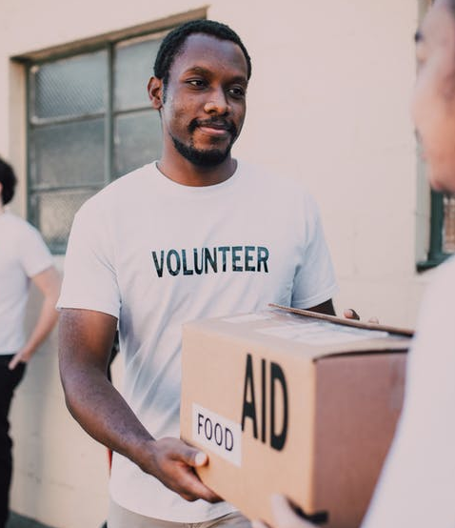
Critical Thinking about Big Aid
While the language of aid and development suggests generosity, in reality the models of aid that were developed usually protected the political and economic interests of the wealthy nations.
The dominant assumption is that aid money has been misspent by corrupt Third World Governments but the reality is far more complex.
Historically, aid has been tied to conditions such as the use of technical advisors, equipment, and supplies that do more to benefit the donor country and organizations than those receiving the aid.
Many large-scale aid initiatives (whether by nations or by large charities) have done little to improve the lives of those most in need.
International money has been mismanaged and spent on poorly planned projects.
Photo by RODNAE Productions from Pexels
Notes:
While the language of aid and development suggests generosity, in reality the models of aid that were developed usually protected the political and economic interests of the wealthy nations.
The dominant assumption is that aid money has been misspent by corrupt Third World Governments but the reality is far more complex.
Historically, aid has been tied to conditions such as the use of technical advisors, equipment, and supplies that do more to benefit the donor country and organizations than those receiving the aid.
Many large-scale aid initiatives (whether by nations or by large charities) have done little to actually improve the lives of those most in need.
International money has been mismanaged and spent on poorly planned projects.

Slide 16
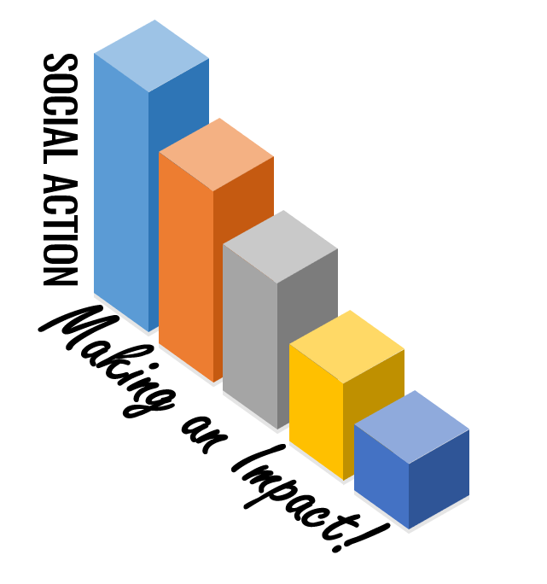
Social Action from the Bottom Up
With grassroots activism the agenda is usually driven by the whole community of involved activists.
Grassroots activism also often focuses on local issues.
The group operates in a spontaneous and informal way and grows organically with all members being part of the decision-making process.
An Example is … Barefoot College
Artwork by Hi Profile is licensed under a CC BY-NC-SA 4.0 International License.
Notes:
With grassroots activism the agenda is usually driven by the whole community of involved activists.
Grassroots activism also often focuses on local issues.
The group operates in a spontaneous and informal way and grows organically with all members being part of the decision-making process.
An Example is … Barefoot College

Slide 17
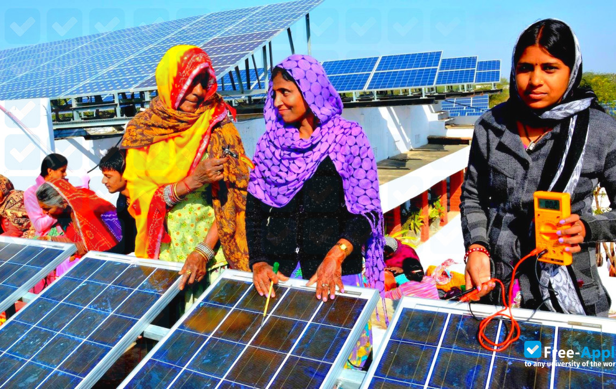

EXAMPLE: Barefoot College
Another example of grassroots social action is Barefoot College (BFC) founded in 1972 by Bunker Roy in Afghanistan.
The college teaches the poor, rural people who make less than $1/day useful skills and knowledge. The college particularly focuses on the education of rural women.
BFC is built on a principle of respect for the identity and culture of participants who dictate the curriculum. It takes into account local needs.
Photo From barefootcollege.org
Notes:
Another example of grassroots social action is Barefoot College (BFC) founded in 1972 by Bunker Roy in Afghanistan.
The college teaches the poor, rural people who make less than $1/day useful skills and knowledge. The college particularly focuses on the education of rural women.
BFC is built on a principle of respect for the identity and culture of participants who dictate the curriculum. It takes into account local needs.

Slide 18

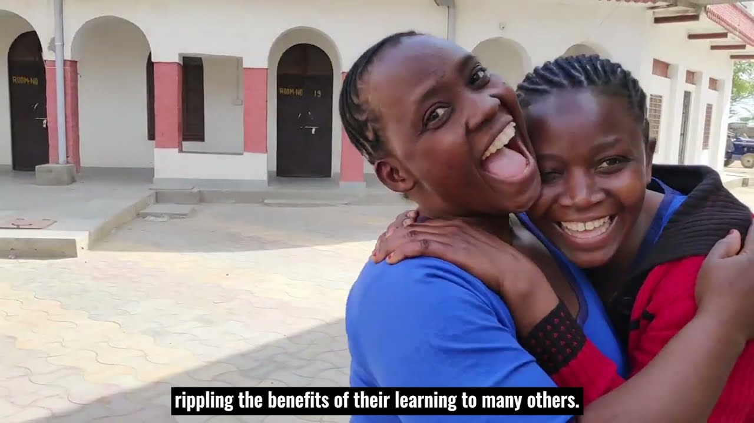
Notes:
Our Story: Barefoot College International
https://youtu.be/5Yw-kQG4P8Q

Slide 19
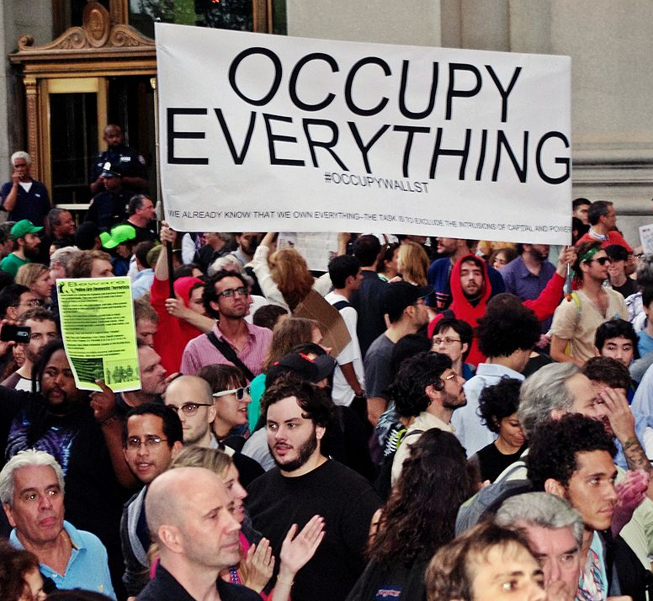
EXAMPLE: Occupy Wall Street
Occupy Wall Street (OWS) was a protest movement against economic inequality that began in Zuccotti Park, located in New York City's Wall Street financial district, in September 2011. It gave rise to the wider Occupy movement in the United States and other countries.
It was a global network of many activist groups protesting social and economic inequality.
The slogan of Occupy Wall Street, “We are the 99%” reflects the commitment to resist the policies of the 1% who control most of the world’s resources.
It has a strategy that is grassroots in its rejection of top-down solutions.
Photo By David Shankbone Public Domain CC BY 3.0
Notes:
Occupy Wall Street (OWS) was a protest movement against economic inequality that began in Zuccotti Park, located in New York City's Wall Street financial district, in September 2011. It gave rise to the wider Occupy movement in the United States and other countries.
It was a global network of many activist groups protesting social and economic inequality.
The slogan of Occupy Wall Street, “We are the 99%” reflects the commitment to resist the policies of the 1% who control most of the world’s resources.
It has a strategy that is grassroots in its rejection of top-down solutions.

Slide 20
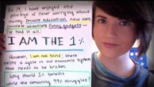
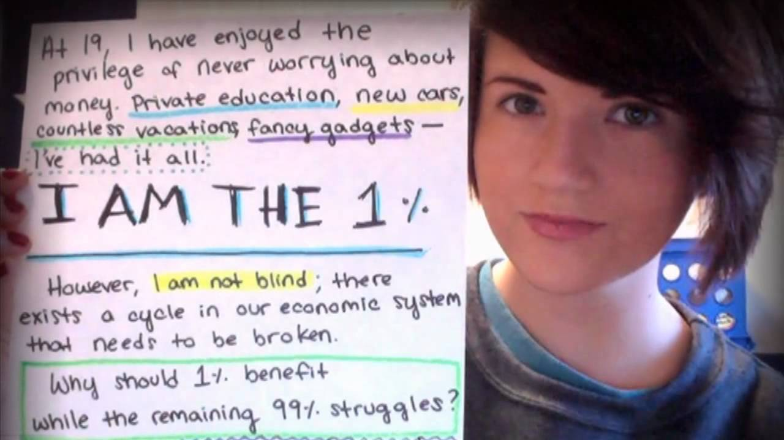
Notes:
Occupy Wall Street (OWS) first came to widespread attention in 2011 with demonstrations in New York City.
It is a global network of many activist groups protesting social and economic inequality.
The slogan of Occupy Wall Street, “We are the 99%” reflects the commitment to resist the policies of the 1% who control most of the world’s resources.
It has a strategy that is grassroots in its rejection of top-down solutions.
https://youtu.be/KFOWci6yrSs

Slide 21

Grassroots Activism
-Obstacles & Challenges
The most significant challenge faced by grassroots initiatives such as Occupy Wall Street is how to engage with the structures that produce the original problems.
The constant pressure to compromise, conform, or give up makes grassroots organizing for social change an objective that is difficult to achieve.
Grassroots activism also often involves a tremendous investment of time, energy, and resources. Those involved are rarely compensated financially.
Seemingly simple things like putting up posters or organizing rallies require effort and commitment.
Photo by PNW Production - Pexels.com
Notes:
The most significant challenge faced by grassroots initiatives such as Occupy Wall Street is how to engage with the structures that produce the original problems.
The constant pressure to compromise, conform, or give up makes grassroots organizing for social change an objective that is difficult to achieve.
Grassroots activism also often involves a tremendous investment of time, energy, and resources. Those involved are rarely compensated financially.
Seemingly simple things like putting up posters or organizing rallies require effort and commitment.

Slide 22

Online Activism
Online activism is an increasingly powerful tool for raising awareness of issues and organizing people around the world to work towards social change.
Online activism – and social networking: Offer many advantages… It can reach millions of people instantly and bring together individuals and organizations separated by time and distance.
Many grassroots organizations use the internet to organize and bring attention to their cause.
But online activism can also become slacktivism. Critics point out that it can become the easy option requiring little commitment and participation. It can make people feel good rather than actually changing the status quo.
Image by vectorjuice - freepik.com
Notes:
Online activism is an increasingly powerful tool for raising awareness of issues and organizing people around the world to work towards social change.
Online activism – and social networking – offers many advantages. It can reach millions of people instantly and bring together individuals and organizations separated by time and distance.
Many grassroots organizations use the internet to organize and bring attention to their cause.
But online activism can also become slacktivism. Critics point out that it can become the easy option requiring little commitment and participation. It can make people feel good rather than actually changing the status quo.
[possible question] Can pressing ‘like’ on a Facebook page ever be an effective form of activism?
[possible question] Can you think of any causes that have successfully used social media to raise awareness or money over an issue?

Slide 23

Social Entrepreneurship – “Good” Profit?
Social Entrepreneurship: Business for both profit and social good.
TOMS shoes is an example of social entrepreneurship. For ever pair of shoes that you buy, TOMS donates a pair to a child in need.
The Body Shop appeals to consumers by insisting that it does not test its products on animals.
Fair Trade products commit to working with farmers and producers to ensure they are paid a fair wage.
Photo by creativeart - freepik.com
Notes:
Social Entrepreneurship: Business for both profit and social good.
TOMS shoes is an example of social entrepreneurship. For ever pair of shoes that you buy, TOMS donates a pair to a child in need.
The Body Shop appeals to consumers by insisting that it does not test its products on animals.
Fair Trade products commit to working with farmers and producers to ensure they are paid a fair wage.

Slide 24

SOCIAL IMPACT
Many people have questioned whether corporations can truly act in the public interest.
Critics of social entrepreneurship have raised three main concerns:
Corporations are concerned with profit over and above all else.
Companies have frequently failed to live up to their promises and social benefit of their practices is often found to be exaggerated.
Social entrepreneurship usually does not address the root causes of a problem.
While TOMS gives children in need a pair of shoes, it does little to tackle the underlying issue of poverty.
What do you think?
Photo by Josh Willink on StockSnap
https://yaleglobalhealthreview.com/2016/07/08/toms-impact-and-effectiveness-of-buy-one-give-one-model/
Notes:
Many people have questioned whether corporations can truly act in the public interest.
Critics of social entrepreneurship have raised three main concerns:
Corporations are concerned with profit over and above all else.
Companies have frequently failed to live up to their promises and social benefit of their practices is often found to be exaggerated.
Social entrepreneurship usually does not address the root causes of a problem.
For example, while TOMS gives children in need a pair of shoes, it does little to tackle the underlying issue of poverty.
What do you think?

Slide 25
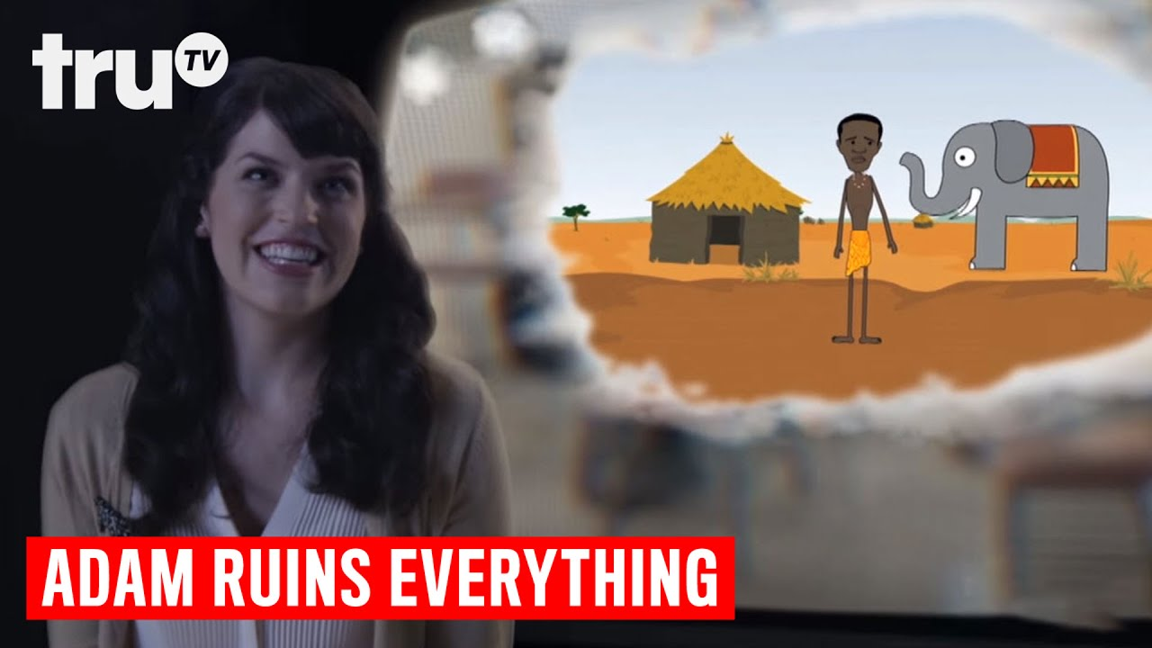
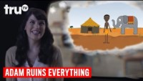
Notes:
https://youtu.be/hX0g66MWbrk

Slide 26

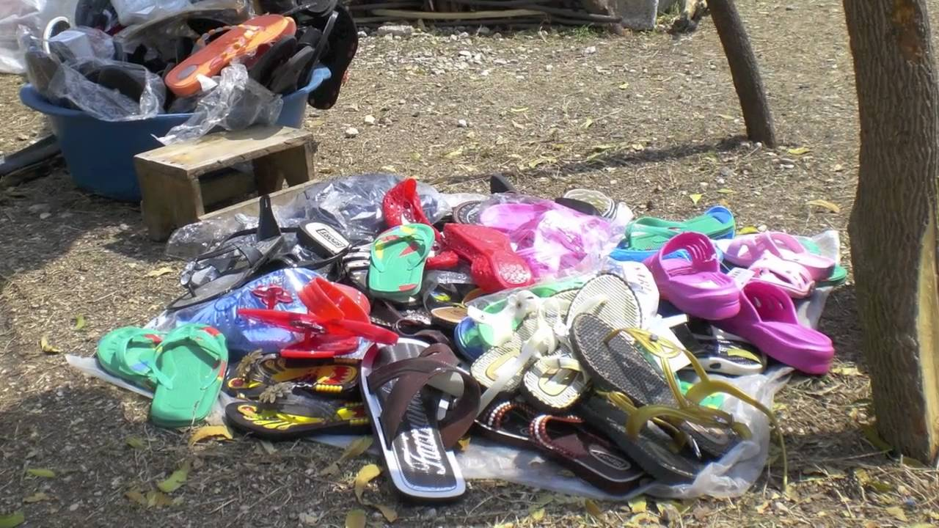
Notes:
A Day Without Dignity
https://youtu.be/isxxQm2_ud0

Slide 27
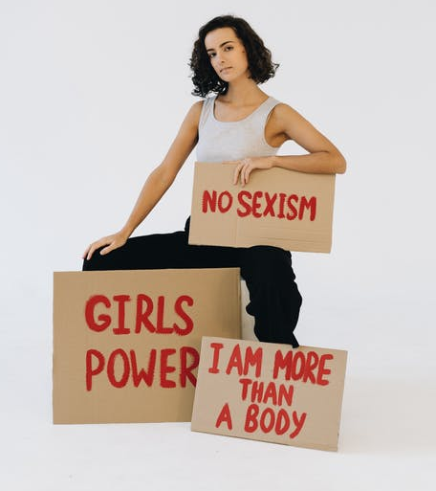
Social Movements
When social action occurs at a group level over a sustained period of time it can become a social movement.
Social Movement: A group of people with a common ideology who try to achieve common goals.
Social movements are organized groups of people working to encourage or discourage social change.
Photo by olia danilevich - Pexels
Notes:
When social action occurs at a group level over a sustained period of time it can become a social movement.
Social Movement: A group of people with a common ideology who try to achieve common goals.
Social movements are organized groups of people working to encourage or discourage social change.

Slide 28
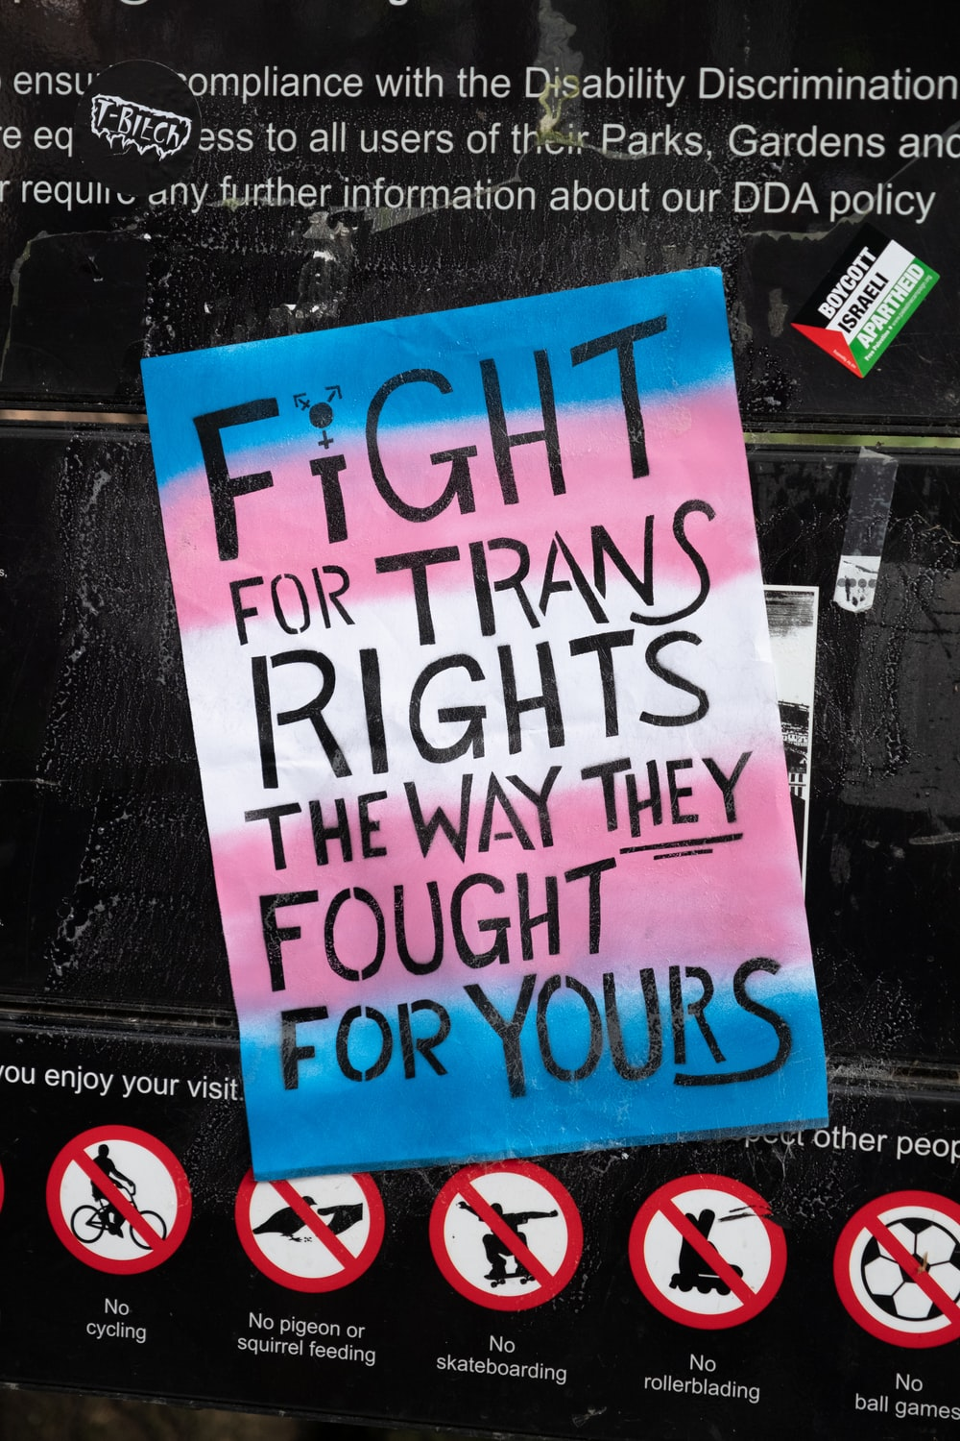
TYPES OF Social Movements
Alternative Social Movements
Aim to effect change at the at a limited level. They are issue-driven and focus on addressing a single concern. Mothers Against Drunk Driving (MADD) is an example of an alternative social movement.
Redemptive Social Movements
Brings together individuals with similar concerns in order to discuss a particular problem, reform, or improve their lives. Alcoholics Anonymous is an example of a redemptive social movement.
Reformative Social Movements
Seek minor changes that focus on society as a whole rather than on the individual. Respond to the social needs of people and communities by providing programs and assistance. Reformative social movements aim to bring gradual yet widespread change. Examples include: the YMCA and the Salvation Army.
Revolutionary Social Movements
Seek radical changes across an entire society. Revolutionary social movements seek to change dominant economic, political, or ideological systems. Occupy Wall Street, the Women’s Movement, and the Civil Rights Movement are all examples of revolutionary social movements.
Photo by Ehimetalor Akhere Unuabona on Unsplash
Notes:
Alternative Social Movements
Aim to effect change at the at a limited level. They are issue-driven and focus on addressing a single concern. Mothers Against Drunk Driving (MADD) is an example of an alternative social movement.
Redemptive Social Movements
Brings together individuals with similar concerns in order to discuss a particular problem, reform, or improve their lives. Alcoholics Anonymous is an example of a redemptive social movement.
Reformative Social Movements
Seek minor changes that focus on society as a whole rather than on the individual. Respond to the social needs of people and communities by providing programs and assistance. Reformative social movements aim to bring gradual yet widespread change. Examples include: the YMCA and the Salvation Army.
Revolutionary Social Movements
Seek radical changes across an entire society. Revolutionary social movements seek to change dominant economic, political, or ideological systems. Occupy Wall Street, the Women’s Movement, and the Civil Rights Movement are all examples of revolutionary social movements.

Slide 29
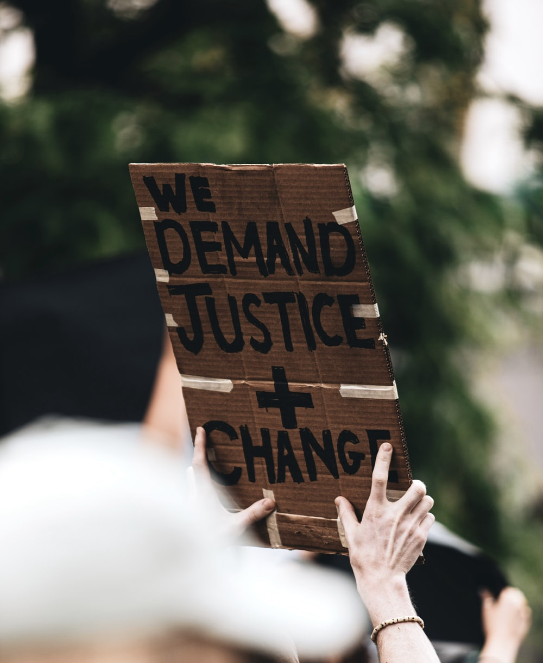
Social Justice & Charity
Social Justice and Charity are both forms of social action.
But their goals and impact are different.
Charity is aimed at providing for the immediate needs of others through direct services.
Food banks, shelters, donating money.
It is valuable for those in need, but it deals with the symptoms of a problem. Charity does not address the root causes of social problems.
Social justice involves collective public acts that promote social change in institutions and society. It is focused not on the symptoms but the root of a problem – the ideologies and institutions that structure individual acts.
Social Justice advocates to changes to the political, social, and/or economic system so that people have more equal opportunities.
Photo by LOGAN WEAVER | @LGNWVR on Unsplash
Notes:
Social Justice and Charity are both forms of social action.
But their goals and impact are different.
Charity is aimed at providing for the immediate needs of others through direct services.
Food banks, shelters, donating money.
It is valuable for those in need but it deals with the symptoms of a problem. Charity does not address the root causes of social problems.
Social justice involves collective public acts that promote social change in institutions and society. It is focused not on the symptoms but the root of a problem – the ideologies and institutions that structure individual acts.
Social Justice advocates to changes to the political, social, and/or economic system so that people have more equal opportunities.

Slide 30
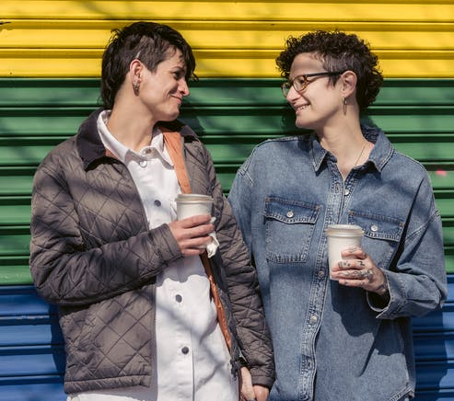
Activism, Allyship, & Advocacy
Expressing oneself is a part of being human. To be deprived of a voice is to be told you are not a participant in society; ultimately it is a denial of humanity.
What distinguishes an activist from someone who simply supports a cause is their level of engagement.
An ally, may not specifically be associated with or belong to a marginalized group, but does support a group’s struggles for equality and social justice.
Photo by Sarah Chai from Pexels
Notes:
Expressing oneself is a part of being human. To be deprived of a voice is to be told you are not a participant in society; ultimately it is a denial of humanity.
What distinguishes an activist from someone who simply supports a cause is their level of engagement?
An ally, may not specifically be associated with or belong to a marginalized group, but does support a group’s struggles for equality and social justice?

Slide 31

Challenges to Social Action
Social action is usually understood as an action that promotes a goal of positive change.
However, as our beliefs, values and ideologies differ, so do our ideas about what constitutes positive change, as Malala Yousafzai’s case illustrates.
It is important to note that not all social action works towards social justice.
Social action can be initiated by anyone with any agenda. Some social action arises as a backlash to those fighting for social justice reform, usually when it collides with the value systems or the privileges of a group who benefits from keeping things the way they are.
Photo created by rawpixel.com - freepik.com
Notes:
Social action is usually understood as an action that promotes a goal of positive change.
However, as our beliefs, values and ideologies differ, so do our ideas about what constitutes positive change, as Malala Yousafzai’s case illustrates.
Malala is an education activist in Pakistan and became the youngest Nobel Peace Prize laureate and human rights advocate. While on a bus after taking an exam, Yousafzai and two other girls were shot by a Taliban Pakistan gunman in an assassination attempt in direct retaliation for her activism. Yousafzai shot in the head with a bullet and remained unconscious and in critical condition. Her condition later improved, and she made a recovery. She went on to tell her story which sparked an international outpouring of support for her and her cause of education for girls in Pakistan.
It is important to note that not all social action works towards social justice.
Social action can be initiated by anyone with any agenda. Some social action arises as a backlash to those fighting for social justice reform, usually when it collides with the value systems or the privileges of a group who benefits from keeping things the way they are.

Slide 32
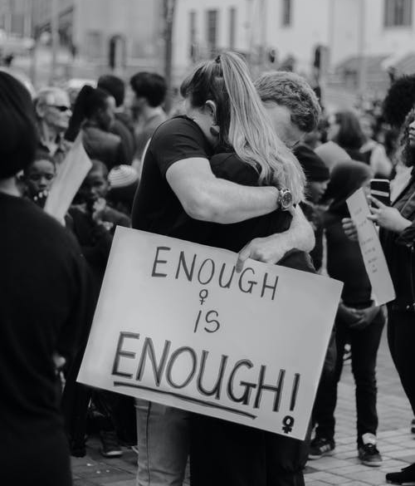
Challenges to Social Action
This backlash could originate from political, social or community groups serving a variety of interests that may be contrary to the principles of social justice.
Hate groups are some of the most active and effective local and global organizers, using both online and mainstream media to make their causes visible.
Photo by Duané Viljoen from Pexels
Notes:
This backlash could originate from political, social or community groups serving a variety of interests that may be contrary to the principles of social justice.
Hate groups are some of the most active and effective local and global organizers, using both online and mainstream media to make their causes visible.

Slide 33
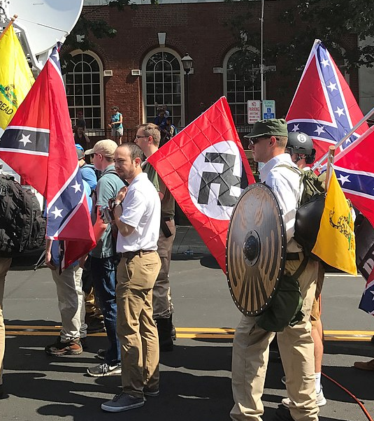
BACKLASH
Fear, anger or resistance to a social ideology or actions intended to address social problems.
Backlash can range from words and labels used to undermine social action, to organized violence.
Labels like “special interests,” for instance, make social action for change sound like “fringe movements” that only concern a few.
Charlottesville 'Unite the Right' Rally Photo by Anthony Crider CC BY 2.0
Notes:
Engaging in social action has brough out BACKLASH from those whose interests and ideologies are challenged.
Fear, anger or resistance to a social ideology or actions intended to address social problems.
Backlash can range from words and labels used to undermine social action, to organized violence.
Labels like “special interests,” for instance, make social action for change sound like “fringe movements” that only concern a few.
Politicians, the media and the police often label social action, which includes both activists and advocacy, as ‘special interests’. But There is nothing special about needing to, or wanting to, feed the hungry and house the homeless and care for our vulnerable and underserved
An explanation of the backlash phrase “All lives matter” shows the backlash to the Black Lives Matter Movement (BLM), All Lives Matter and Blue Lives matter came about as a stark contradiction and opposition to the BLM movement

Slide 34

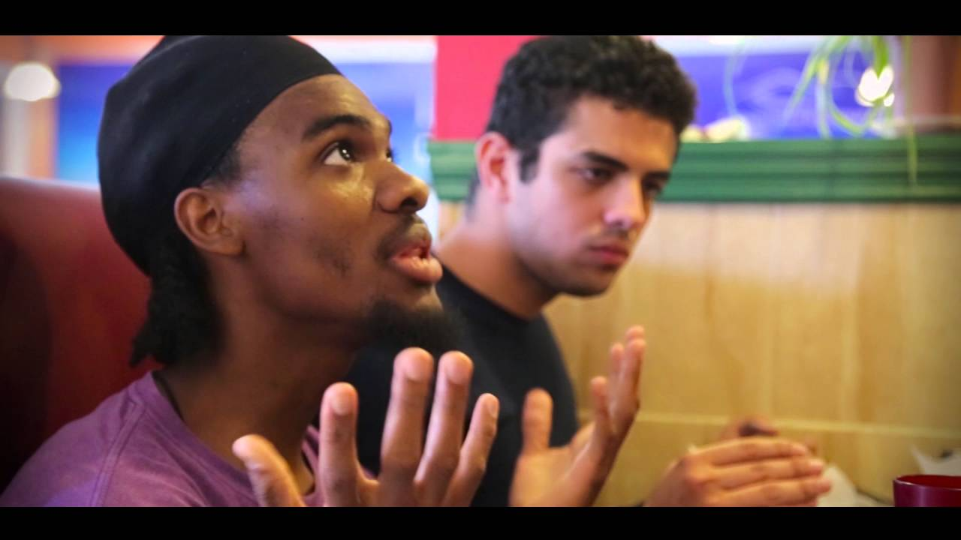
Notes:
All Lives Matter
https://youtu.be/NtAAeyswlHM
By Peace House!

Slide 35
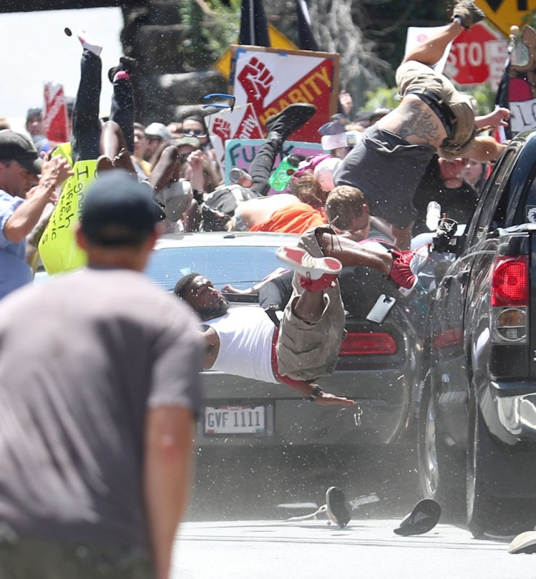
BACKLASH
Fear, anger and resistance to a social cause..
How far will someone go to protect their ideology?
Have a look at this situation where a young man drove a car into a crowd of people taking the life of one and injuring many others!
Photo Ryan M. Kelly | AP Photo
Notes:
Backlash
Fear, anger and resistance to a social cause..
How far will someone go to protect their ideology?
Have a look at this situation where a young man drove a car into a crowd of people taking the life of one and injuring many others!
This example is the action taken by James Fields …
James Fields Jr., who pleaded guilty to federal hate crimes, was sentenced on Friday to life in prison.
Fields rammed his car into a crowd of anti-racism protesters in Charlottesville, Va., in 2017, killing 32-year-old Heather Heyer and injuring 35. He was sentenced to spending the rest of his life in prison.
His attorneys say he had no intent to commit a violent act, instead describing the attack as a "impulsive, angry and aggressive decision."

Slide 36

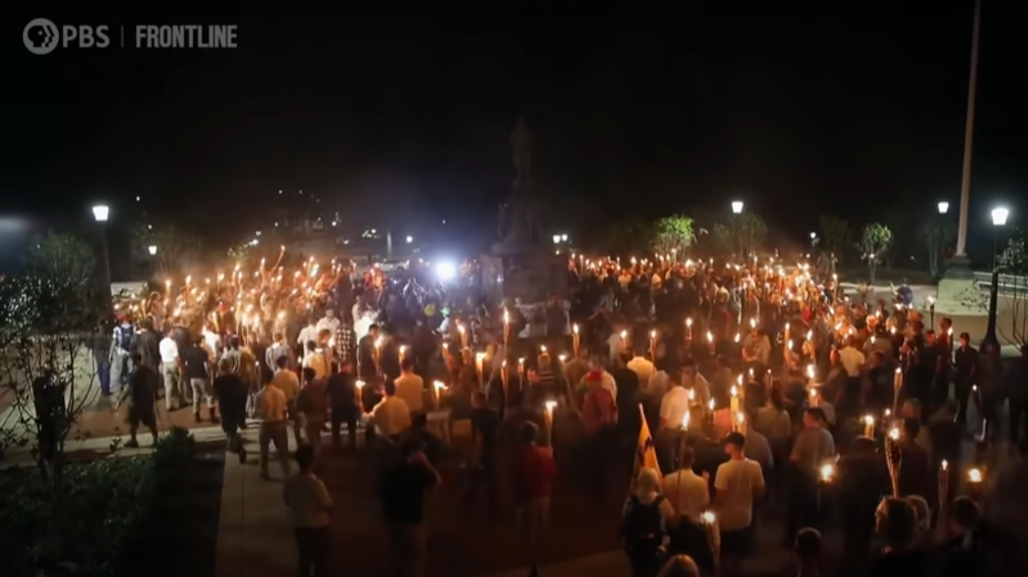
Notes:
A scene from the FRONTLINE documentary "Trump’s American Carnage" shows how the 2017 Unite the Right rally and President Trump’s response foreshadowed Jan. 6, 2021.
https://youtu.be/Vy4F0VSbBkQ

Slide 37

CRITICAL THINKING QUESTIONS?
Critical Thinking Questions:
Did the Charlottesville riot hurt the cause of the anti-racism protesters?
Is uncovering hidden racism a positive outcome of media publicity, or an unwanted platform for hate groups?
Is social action possible without ideology?
Why did the police sit idly by and not respond to the treat while it was happening?
"Critical Thinking“ by epictop10.com
Notes:
Critical Thinking Questions:
Did the Charlottesville riot hurt the cause of the anti-racism protesters?
Is uncovering hidden racism a positive outcome of media publicity, or an unwanted platform for hate groups?
Is social action possible without ideology?
Why did the police sit idly by and not respond to the treat while it was happening?

Slide 38















Discussion:
“Give a man a fish and he will eat for a day. Teach a man to fish and he will eat for a lifetime.”
What does this quote say about difference between charity and social justice?
Artwork by Hi Profile is licensed under a CC BY-NC-SA 4.0 International License.
Notes:
“Give a man a fish and he will eat for a day.
Teach a man to fish and he will eat for a lifetime.”
What does this quote say about difference between charity and social justice?

Slide 39


QUESTIONS
Question Marks created by Starline - freepik.com
Notes:
Questions …

